Slide 1
EPAS Debates

Slide 2
What is EPAS?
We are the European Parliament Ambassador Scheme, and we raise awareness about the EU and run events!
You may have seen our informational board on the top corridor or attended our stall at the Christmas fair.
You will have also seen us run an assembly last term.
You can follow us on Instagram @stroudhighepas

Slide 3
Today
You will be debating on different EU issues as the UK is still intertwined with Europe (even though we left the EU)
We will take you through the arguments and we would love to hear your thoughts!
After we have debated there will be a vote on each of the issues

Slide 4
Debate 1

Slide 5

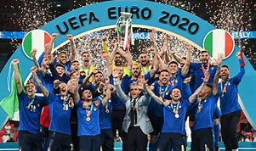
Should we still compete in European events?

Slide 6

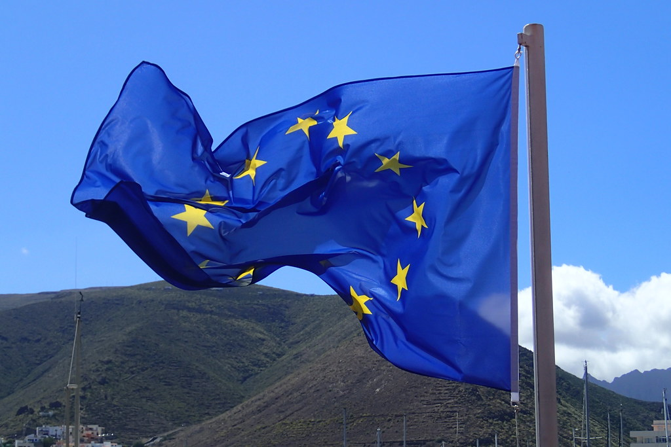

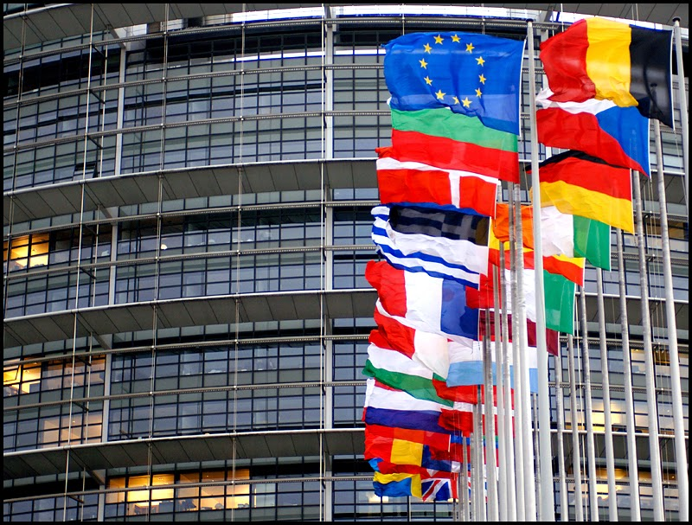
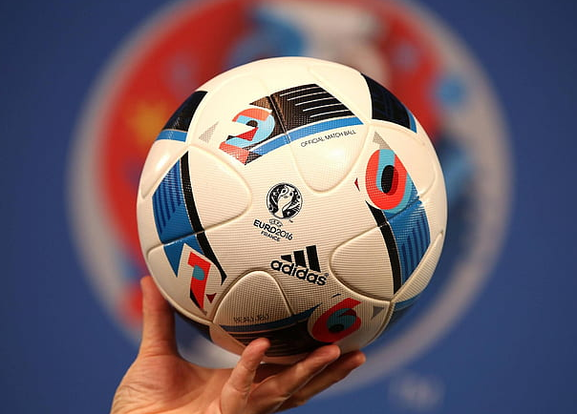

Introduction..
Britain left the European Union in January 2020 – this was called Brexit
Despite no longer being part of the EU, the UK continues to participate in a couple of European events such as...
-Eurovision
-UEFA Euros
Do you think this is fair considering that as a country, Britain chose to leave the EU? Should we be excluded from these European events? Or does the fact that we are located in Europe allow us to continue taking part?
ThePhoto by PhotoAuthor is licensed under CCYYSA.

Slide 7
Arguments for | Arguments against
Economic Advantages- UEFA Women’s Euros generated approximately £81 million across its 8 host cities- also supported 1,2000 full-time equivalent jobs We are still part of the continent of Europe. We have arguably similar cultures and values, and these should be celebrated in these events. We were instrumental in the creation of the European Union and have frequently played an integral part of European affairs and events. Helps maintain relations and a connection with European countries which is hugely important in good international relations. | We consistently receive low scores in events such as Eurovision and we are often perceived as showing a lack of effort which harms relations and an international appearance of the UK. We officially cut ties with the EU through Brexit, and there have been continued tensions between the UK and Europe: so why should we still compete amongst them? As a geographically isolated nation, we as the UK may not resonate as strongly with the rest of the European nations. We involve politics and government too much in entertainment.

Slide 8
Time to debate!

Slide 9
Time to vote!
Which side do you agree with?

Slide 10
Debate 2

Slide 11
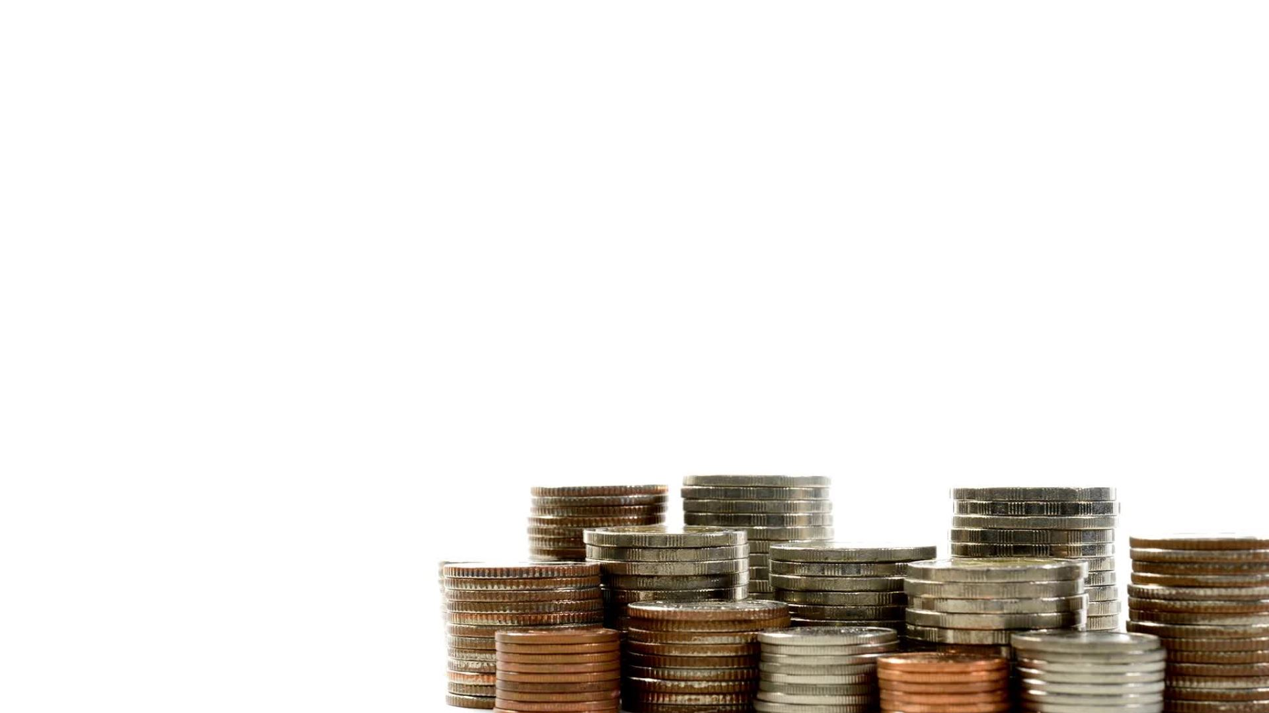
Should the UK introduce the Euro?
By Epas

Slide 12
Introduction
The Euro the official currency of the EU, introduced in 2001
The purpose of the Euro is to make it easier to buy and sell goods and services in most EU member states
Most EU member states use the Euro
The UK never signed up to it, but we would have to if we wanted to rejoin the EU as it is now mandatory

Slide 13
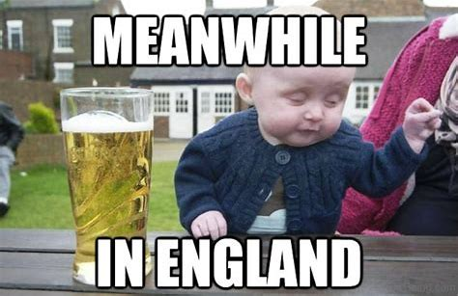

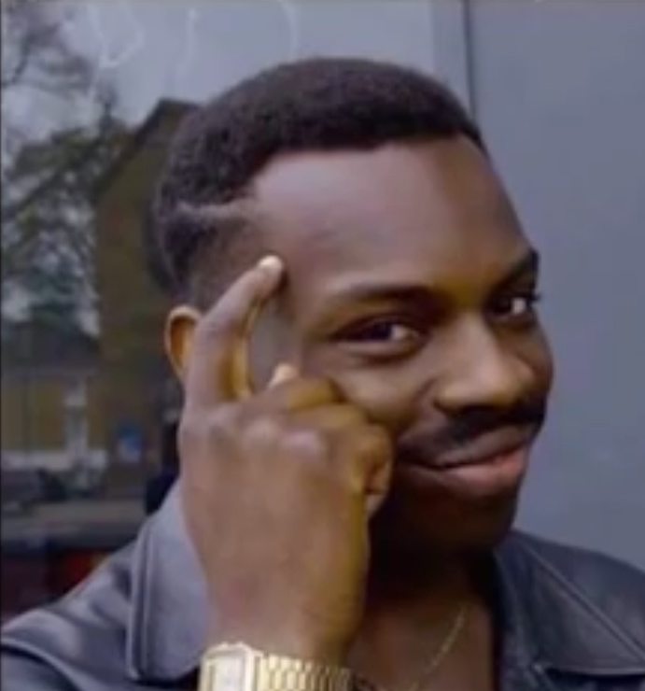
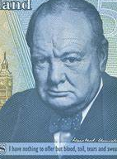
Arguments for | Arguments against
Improved relations with the EU after Brexit After Brexit, the value of a pound fell to its lowest recorded level and adopting the euro UK would help stabilise this Wouldn’t have to pay to convert money as there would be no issue with conversion rates when travelling to Europe Would be easier to compare prices of items when travelling in Europe Most adults can get used to a new currency fairly easily (done before when we changed to pounds and pence from shillings) We won't have coins with irrelevant royal family figures. Better trading with European countries decreasing prices. | The pound is very traditional/historical The euro is heavily associated with the EU which Britain separated from in 2020 The euro has a lower value than the British pound which would decrease the value of the UKs currency National pride reasons. Would require the public to accept/get used to a new currency One interest rate can’t react as quickly to UK economic shocks (cosy Livs)

Slide 14
Time to debate!

Slide 15
Time to vote!
Which side do you agree with?

Slide 16
Debate 3

Slide 17
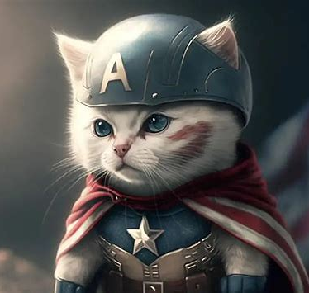
Should AI have a greater role in society?

Slide 18
What is AI currently used for?
AI has already been integrated into many areas of life already such as:
Choosing what information and content you see online
Summaries articles for google explanations
Is used by Hollywood, the video games industries and marketing departments to generate pictures and video
Used in medicine to help with diagnoses

Slide 19
Arguments for
AI can be used to automate menial tasks
AI has many medical uses such as making quick diagnoses
AI can make looking for information online more streamlined and less subjective*
AI can be used by people whose first language isn't English to help when writing job applications and other important documents
Convenient – it's often quicker and simpler to get straight forward answers by using language models such as chat GPT
Arguments against
AI has a huge negative impact on the environment – 134 terawatt - uses more power than the country of Bangladesh
Only as good as its training data – biases in training data can get amplified
Can lead to the loss of jobs in creative fields such as art and poetry
Can lead to the loss of skills in certain fields made redundant
Can be used by bad actors online to spread misinformation and hatred

Slide 20
Time to debate!

Slide 21
Time to vote!
Which side do you agree with?

Slide 22
Debate 4

Slide 23

Do you think social media should be banned for under 16s?

Slide 24
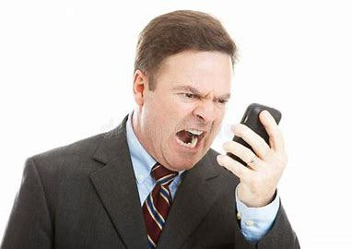






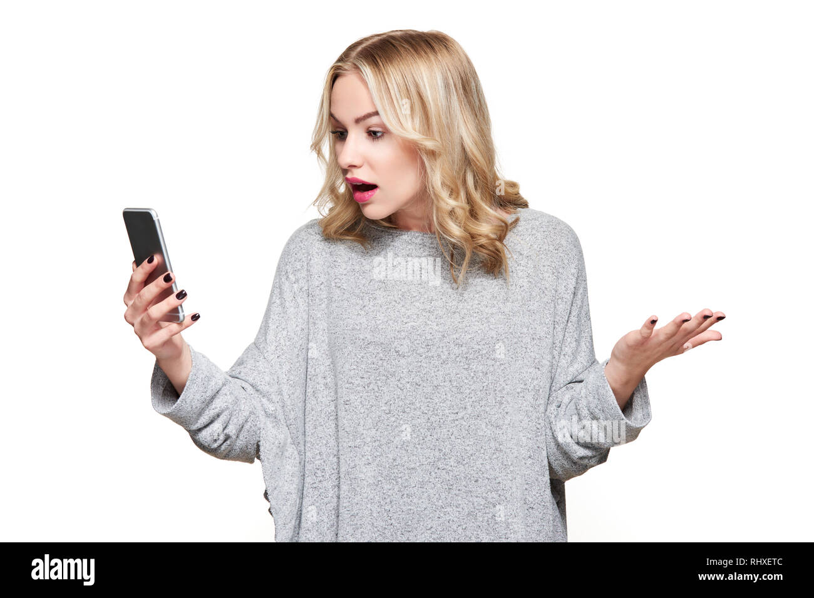
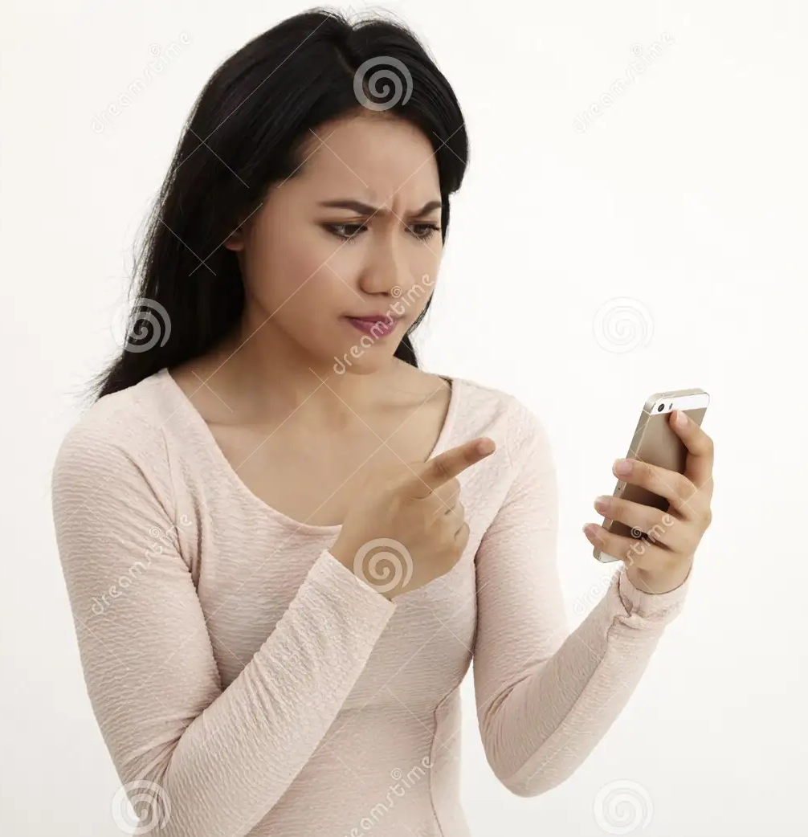


Do you think social media should be banned for under 16s?
Australia recently made the decision to ban social media for under 16s the ban will include: Snapchat, Facebook, Instagram and X. However, many other apps and websites for gaming and chatting will still be available.
Would you prefer if the apps and websites you used were only used by people 16 or under? Do you think they could create an online space where you would feel more able to express yourself and your interests without worrying about the opinions of people much older than you?

Slide 25
Arguments for | Arguments against
Protects young people's mental health Stops the spread of misinformation (i.e. fake news, incorrect information to stretch the truth, clickbait, etc.) Stop cyberbullying Exposure to inappropriate content is reduced Prevent addiction Prevents people from sharing things online that they may regret later on | Prevents people from being able to connect with friends and family on social media Allows people to learn new things Allows people to express themselves creatively (i.e. artwork, writing, music, baking, etc) Can be a valuable tool for social and political activism Hard to enforce so could lead to unsupervised access to social media

Slide 26
Time to debate!

Slide 27
Time to vote!
Which side do you agree with?

Slide 28
Thank you for taking part!

