Slide 1


Slide 2


Slide 3

Do & Review
What do you already know about the Eurovision Song Contest?
What French words can you think of that could be related to music?

Slide 4
Learning Objective
To give justified opinions about songs from Eurovision 2026 in French.
Key words Key question Wider life
J’adore Tu aimes la chanson … ? The Eurovision Song Contest is the largest
J’aime televised non-sporting event in the world.
Je n’aime pas It has been running for 70 years and
Je déteste the UK has participated since 1957.
Its slogan is ‘United By Music’, aiming to
bring the different countries of Europe
together through the power of music.

Slide 5
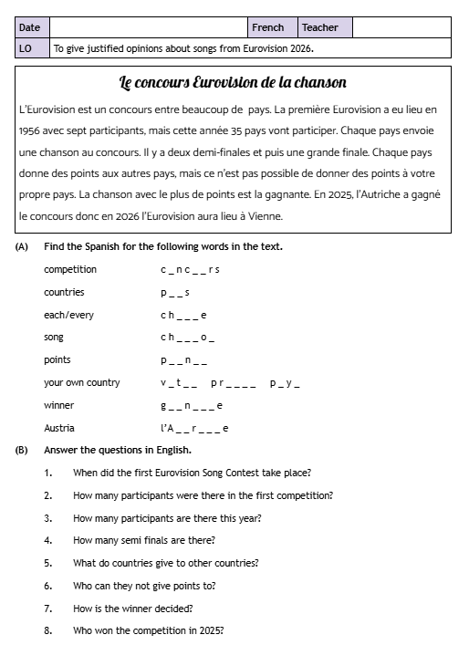
Present/Practice
Read the text about the Eurovision Song Contest and complete the activities.

Slide 6
Share, Check & Improve
competition
countries
each/every
song
points
your own country
winner
Austria
concours
pays
chaque
chanson
points
votre propre pays
gagnante
l’Autriche

Slide 7
Share, Check & Improve
1. When did the first Eurovision Song Contest take place?
2. How many participants were there in the first competition?
3. How many participants are there this year?
4. How many semi finals are there?
5. What do countries give to other countries?
6. Who can they not give points to?
7. How is the winner decided?
8. Who won the competition in 2025?
1. 1956
2. 7
3. 35
4. 2
5. points
6. themselves
7. song with most points
8. Austria

Slide 8
Practice
You are going to listen to a selection of songs from this year’s Eurovision Song Contest.
You need to give a justified opinion for each song in Spanish.
Use a French dictionary to help you, using the second half (words in English and their translations into French).

Slide 9

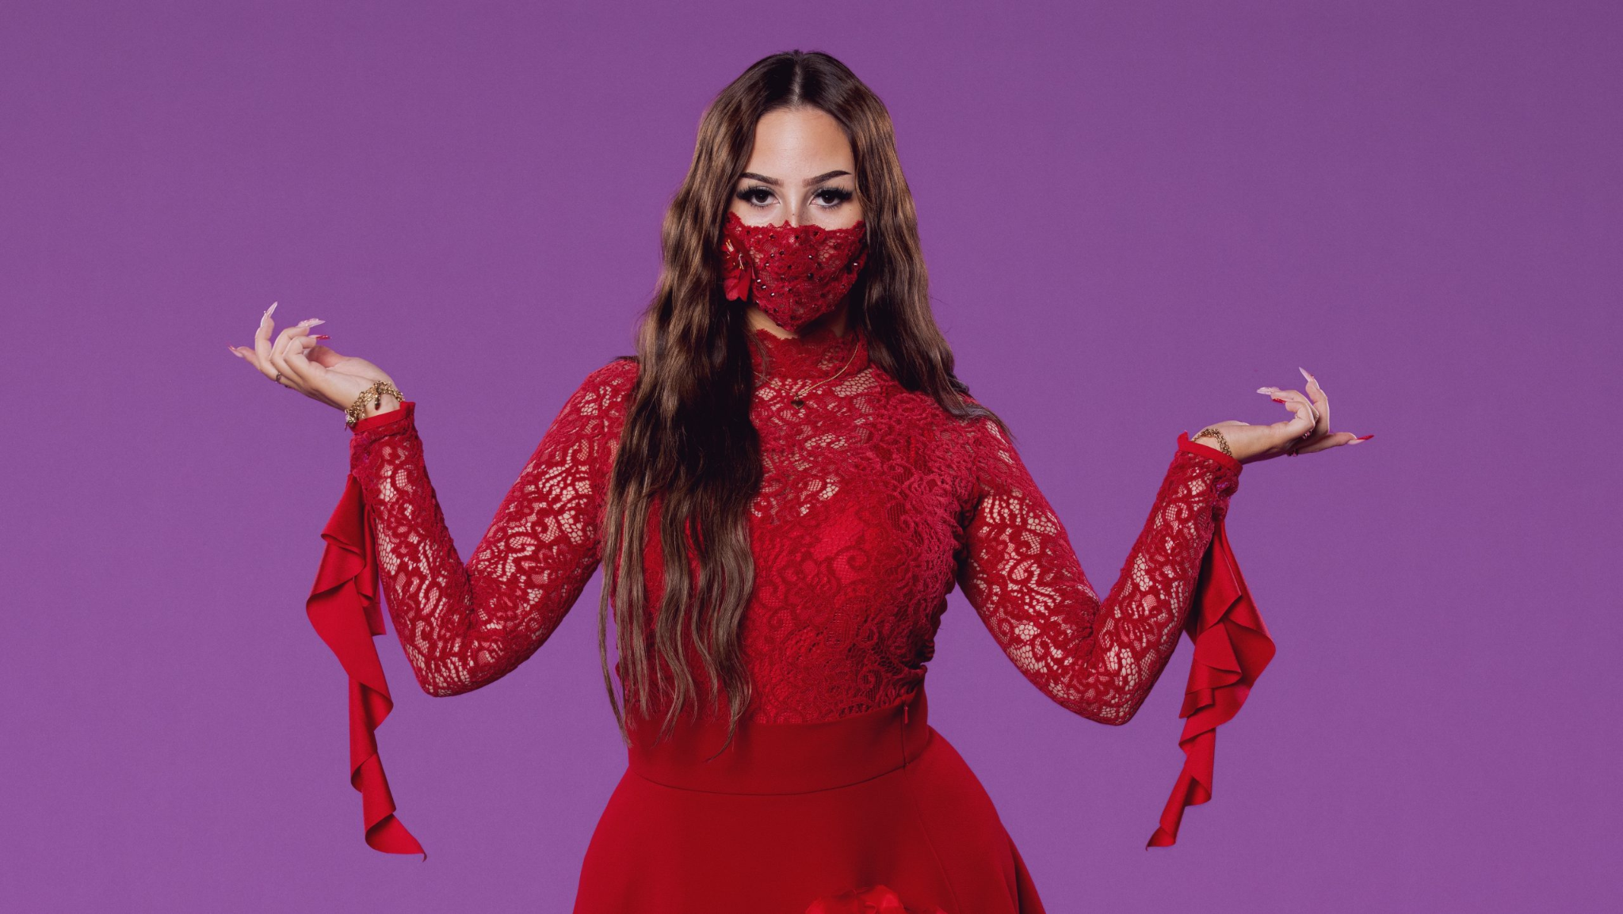
Pays: la Suède
Artiste: Felicia
Chanson: My System

Slide 10


Slide 11
Tu aimes la chanson suédoise ?
Opinion phrase | Noun | Nationality | Connective | Verb | Description
J’adore I love J’aime I like Je n’aime pas I don’t like Je déteste I hate | la chanson the song | suédoise Swedish | car because | elle est it is elle n’est pas it isn’t elle me fait it makes me | [Use a dictionary to find words to finish off your sentence]

Slide 12

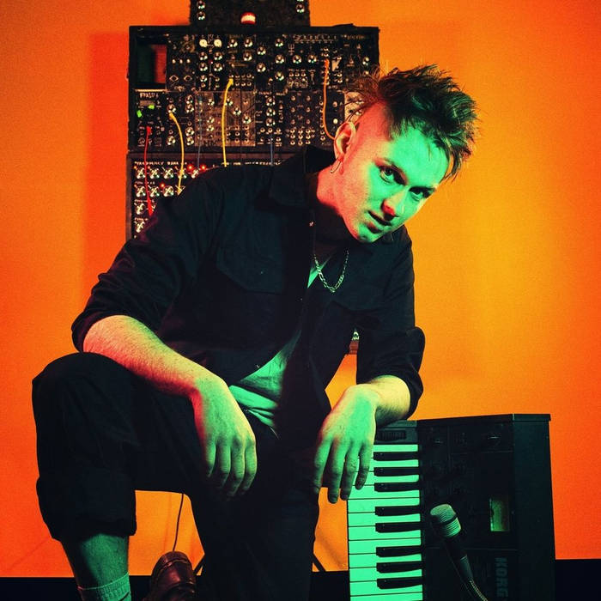
Pays: le Royaume Uni
Artiste: Look Mum No Computer
Chanson: Eins, Zwei, Drei

Slide 13


Slide 14
Tu aimes la chanson britannique ?
Opinion phrase | Noun | Nationality | Connective | Verb | Description
J’adore I love J’aime I like Je n’aime pas I don’t like Je déteste I hate | la chanson the song | britannique British | car because | elle est it is elle n’est pas it isn’t elle me fait it makes me | [Use a dictionary to find words to finish off your sentence]

Slide 15

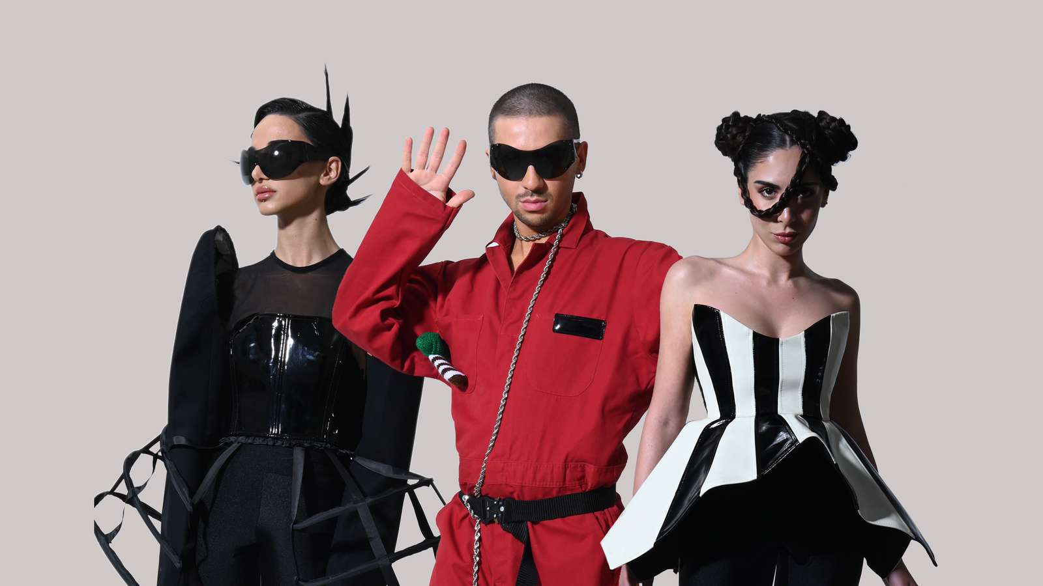
Pays: la Géorgie
Artiste: Bzikebi
Chanson: On Replay

Slide 16


Slide 17
Tu aimes la chanson géorgienne ?
Opinion phrase | Noun | Nationality | Connective | Verb | Description
J’adore I love J’aime I like Je n’aime pas I don’t like Je déteste I hate | la chanson the song | géorgienne Georgian | car because | elle est it is elle n’est pas it isn’t elle me fait it makes me | [Use a dictionary to find words to finish off your sentence]

Slide 18

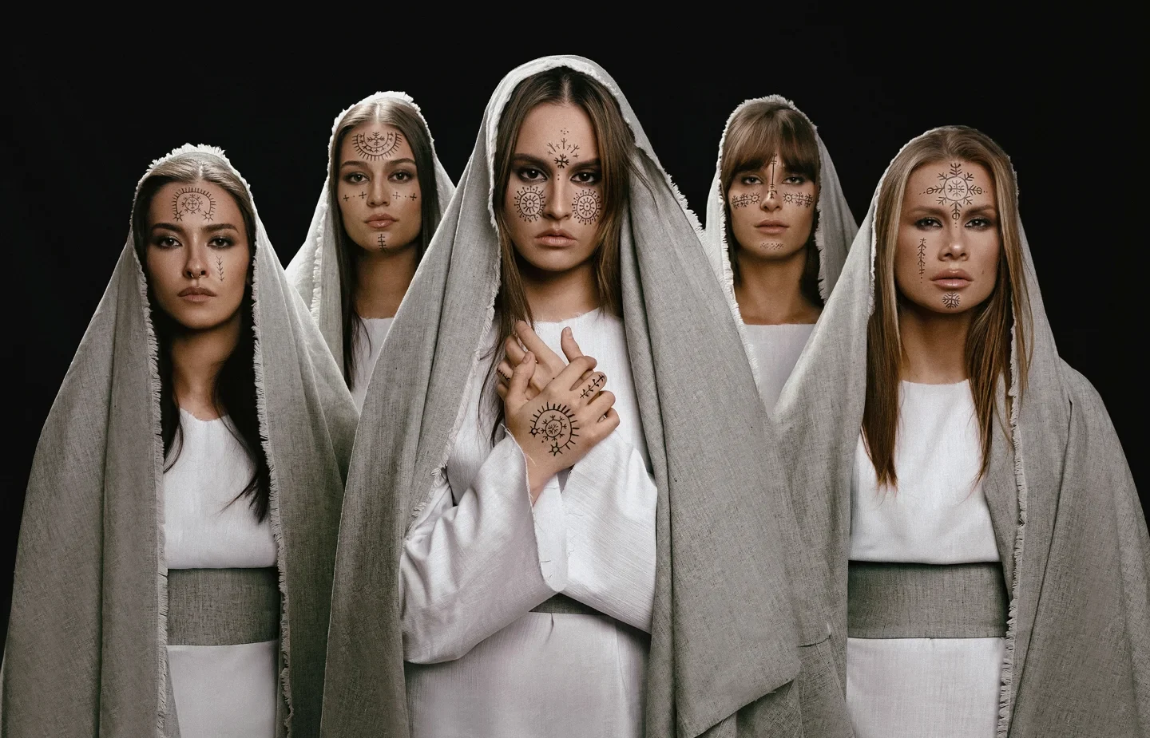
Pays: la Croatie
Artiste: Lelek
Chanson: Andromeda

Slide 19


Slide 20
Tu aimes la chanson croate ?
Opinion phrase | Noun | Nationality | Connective | Verb | Description
J’adore I love J’aime I like Je n’aime pas I don’t like Je déteste I hate | la chanson the song | croate Swedish | car because | elle est it is elle n’est pas it isn’t elle me fait it makes me | [Use a dictionary to find words to finish off your sentence]

Slide 21


Pays: la Bulgarie
Artiste: Dara
Chanson: Bangaranga

Slide 22


Slide 23
Tu aimes la chanson bulgare ?
Opinion phrase | Noun | Nationality | Connective | Verb | Description
J’adore I love J’aime I like Je n’aime pas I don’t like Je déteste I hate | la chanson the song | bulgare Bulgarian | car because | elle est it is elle n’est pas it isn’t elle me fait it makes me | [Use a dictionary to find words to finish off your sentence]

Slide 24

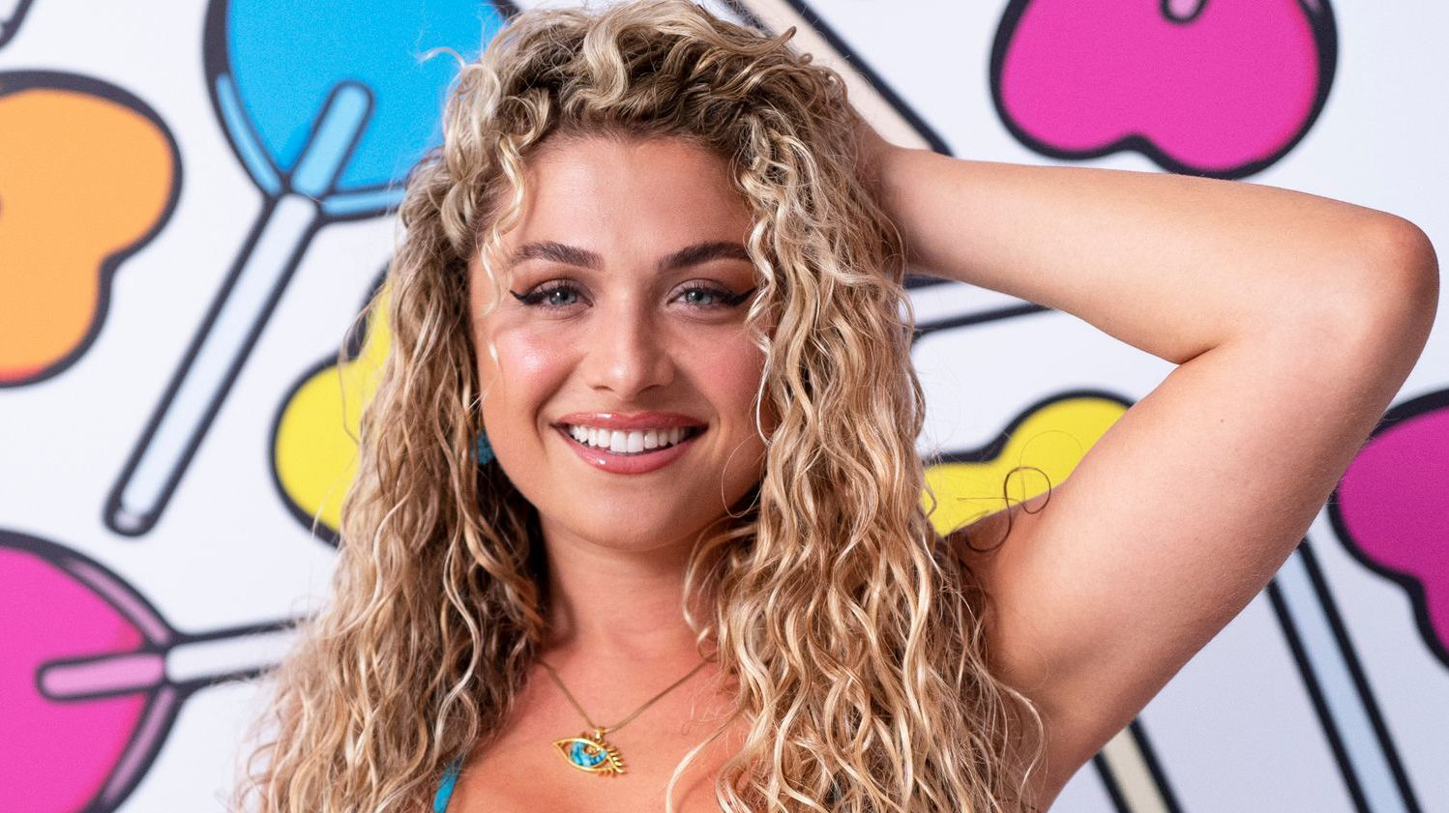
Pays: la Chypre
Artiste: Antigoni
Chanson: Jalla

Slide 25


Slide 26
Tu aimes la chanson chypriote ?
Opinion phrase | Noun | Nationality | Connective | Verb | Description
J’adore I love J’aime I like Je n’aime pas I don’t like Je déteste I hate | la chanson the song | chypriote Cypriot | car because | elle est it is elle n’est pas it isn’t elle me fait it makes me | [Use a dictionary to find words to finish off your sentence]

Slide 27
Reflection:
Quelle est la meilleure chanson ?
Opinion | Nationality | Justification | Adjective
À mon avis, la meilleure chanson c'est la chanson In my opinion, the best song is the [...] song | suédoise britannique géorgienne croate bulgare chypriote | car c’est la chanson la plus because it is the most [...] song | [Use a dictionary to find an adjective to finish off your sentence]

